Slide 1
Video Assisted Thoracic Surgery: Common Conditions treated
Joss Fernandez MD FACS
Boone Heart Surgery
May 6, 2023
Accreditation: Boone Medical Center is accredited by the Missouri State Medical Association to provide continuing medical education for physicians.
Credit: Boone Medical Center designates this live activity for a maximum of 1 AMA PRA Category 1 Credit(s). Physicians should claim only the credit commensurate with the extent of their participation in the activity.

Slide 2
Disclosures
Faculty Disclosures:
Dr. Joss Fernandez, MD has disclosed he has no financial interest or other relationship with the manufacture(s) of the product(s) or any of the services he intends to discuss. There is no conflict of interest.
Planner disclosures:
Planners (Patrick Finney, Kyndal Riffie & Jarod Lafrenz) Disclosures:
All event planners have disclosed that none have any financial interest or other relationship with the manufacture(s) of the product(s) or any of the services to be discussed. There is no conflict of interest.
There is no commercial financial support for this live event

Slide 3
Learning Objectives
1. Recognize common thoracic surgical ailments
2. Understand treatment strategies
3. Familiarization of when to refer patients to thoracic surgeon
4. Understand the postoperative need of patients

Slide 4
Common Thoracic Surgical Ailments for the Primary Care Physician
Spontaneous Pneumothorax
Empyema
Solitary Lung Nodule
Other procedures

Slide 5
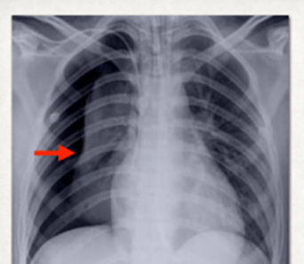
Spontaneous Pneumothorax
Tall, thin individuals, smokers, and those with underlying lung disease.
No antecedent trauma
Forceful inhalation with tobacco or drugs.
The presentation is frequently that of pleuritic chest pain with associated cough.
Diminished breaths sound on exam is not always reliable.

Slide 6
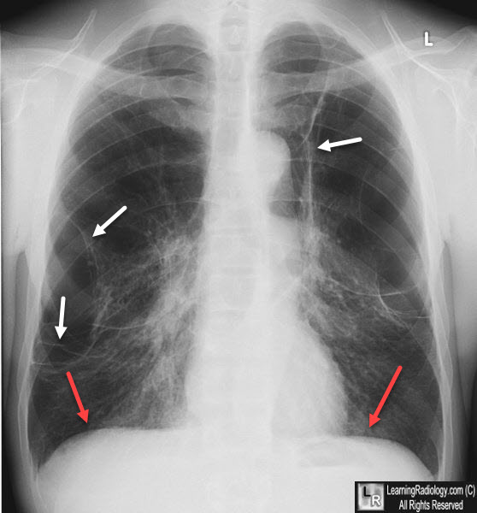
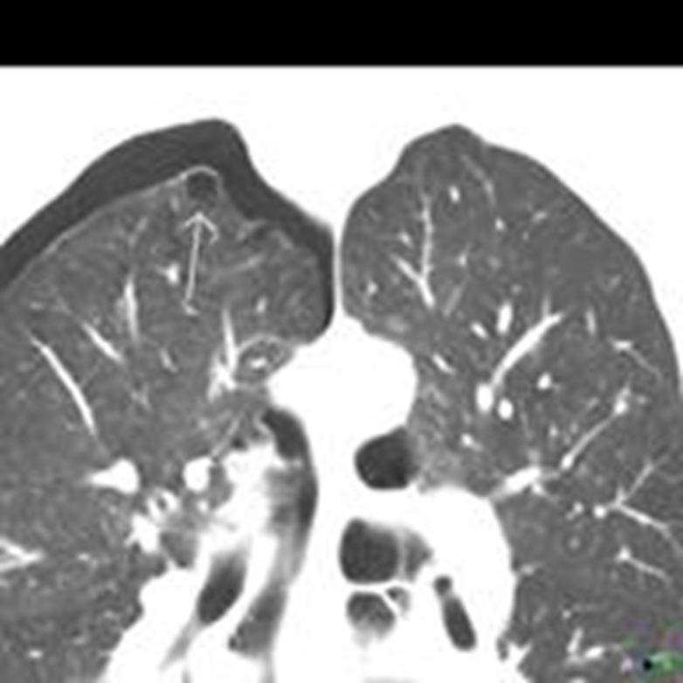
Initial management is supplemental O2
Chest tube
>25% volume loss
Severe emphysematous disease
hypoxia
severe shortness of breath
Those with bullous emphysema will more likely require VATs pleurodesis
CT for those with suspected underlying disease or prior to VATs to help with localization of bullae.

Slide 7
Genetic predisposition
Marfan syndrome
Ehlers-Danlos syndrome
FLCN gene mutation: folliculin, which is involved in the regulation of cell growth and division.
SERPINA1 gene mutation: lead to deficiency in alpha-1 antitrypsin
COL11A1 gene mutation: collagen type XI alpha 1 defects

Slide 8
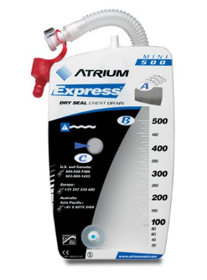
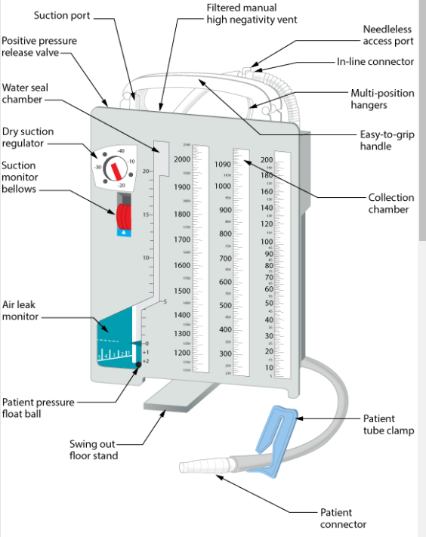
Chest tube management.
Following chest tube placement.
British Society of Thoracic Surgery:
4 year recurrence rate after treatment with chest tube is 54%.
94.4% recur within the first 6 months.

Slide 9
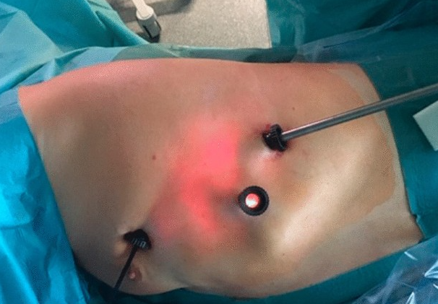
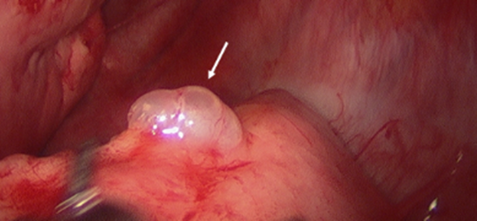
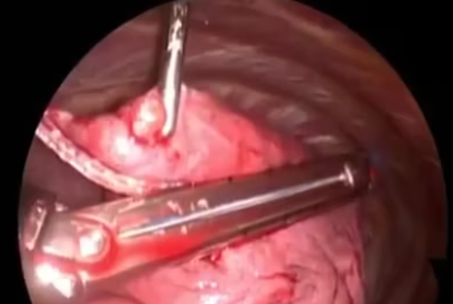
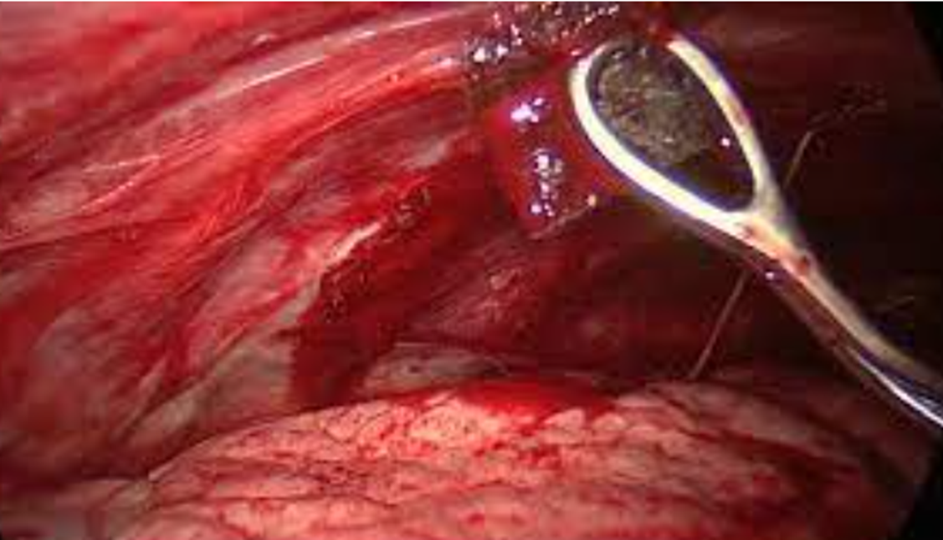
VATS pleurodesis

Slide 10
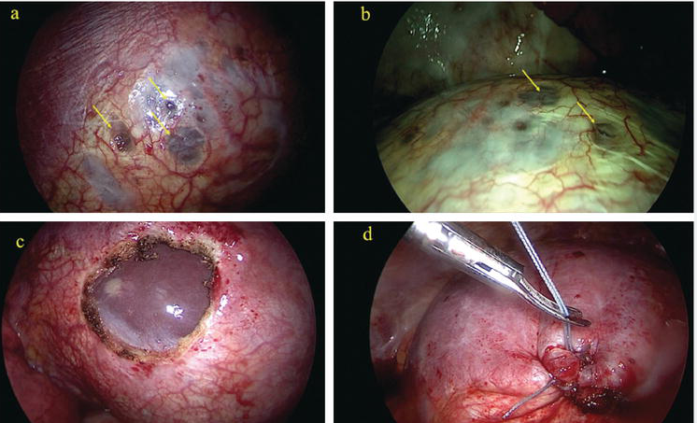
38 yo with spontaneous pneumothorax occurring now 3 times in the last year. It occurs 1-2 days after menses. Failed prior pleurodesis. Catamenial pneumothorax

Slide 11
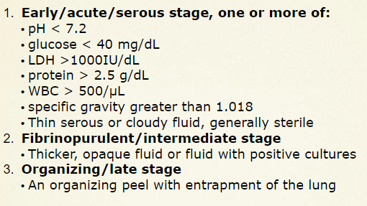
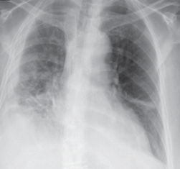
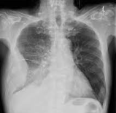
Empyema
Antecedent lower respiratory symptoms that resolve 1-2 weeks prior
Worsening pleuritic chest pain, fevers, cough, SOB
Failed antibiotic course
Streptococcus pneumoniae is the most common bacterial pathogen associated with empyema, followed by Staphylococcus aureus and anaerobic bacteria.

Slide 12
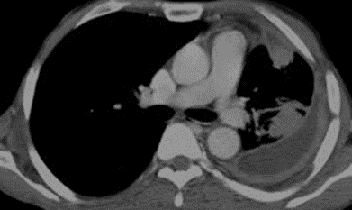
Earlier intervention is easier

Slide 13
Fibrinolytic therapy
Mist2 2011 10mg tPa (Alteplase) + 5 mg Dnase (pulmozyme)
VATS-D (Group 1) was applied to 54 patients and IPFib (Group 2) was applied to 24 patients. The success of both procedures was evaluated considering the need of decortication in the following periods.
In the VATS-D group, 4 (7.4%) patients required decortication via thoracotomy where it was 1 (4.1%) patient (p = 0.577) in the IPFib group.
The length of hospital stay was 6.81 ± 2.55 (4–15) days in Group 1 compared to 14.25 ± 6.44 (7–27) days in Group 2 (p <0.001).
Ozgur Samancilar, Tevfik İlker Akçam, et al. The Efficacy of VATS and Intrapleural Fibrinolytic Therapy in Parapneumonic Empyema Treatment

Slide 14
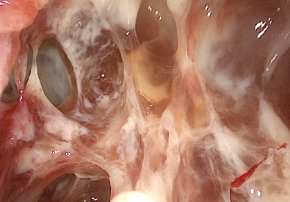
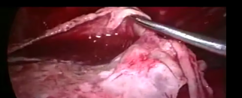

Slide 15
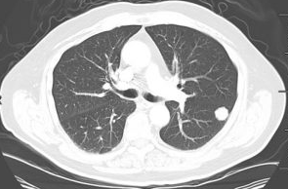
Solitary lung nodules
Fleischner Society Guidelines.
Solid nodules:
<6 mm in a low-risk patient; if it is a high-risk patient, then a repeat CT scan at 12 months
6 to 8 mm, repeat CT in 6 to 12 months and again at 18 to 24 months
If the nodule is >8 mm, consider repeating CT at 3 months versus obtaining a PET/CT or tissue sample.
Gound glass nodules:
<6 mm require no routine follow up.
If >6 mm, then repeat CT at 6 to 12 months, then every 2 years for a total of 5 years.
Partly solid nodules:
<6 mm require no routine follow up.
If >6 mm, the repeat CT at 3 to 6 months, if nodule continues to grow or has persistent solid component >6 mm, the patient is deemed high risk, and resection should be considered.
A CT should be performed annually for 5 years if the nodule is unchanged from a prior and solid component <6 mm.
Biopsy options: The choice of biopsy method depends on the size, location, and characteristics of the nodule, as well as the patient's overall health status. Transbronchial biopsy (TBB) or transthoracic needle biopsy (TTNB) may be used for peripheral nodules, while endobronchial ultrasound (EBUS) may be used for central nodules. Surgical biopsy may be required in certain cases.

Slide 16
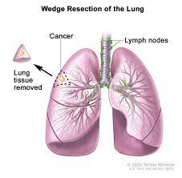
Anatomy

Slide 17
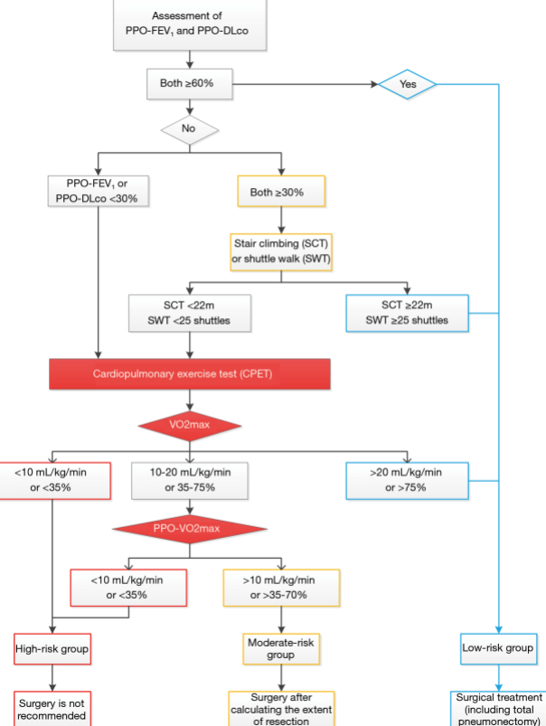

Slide 18
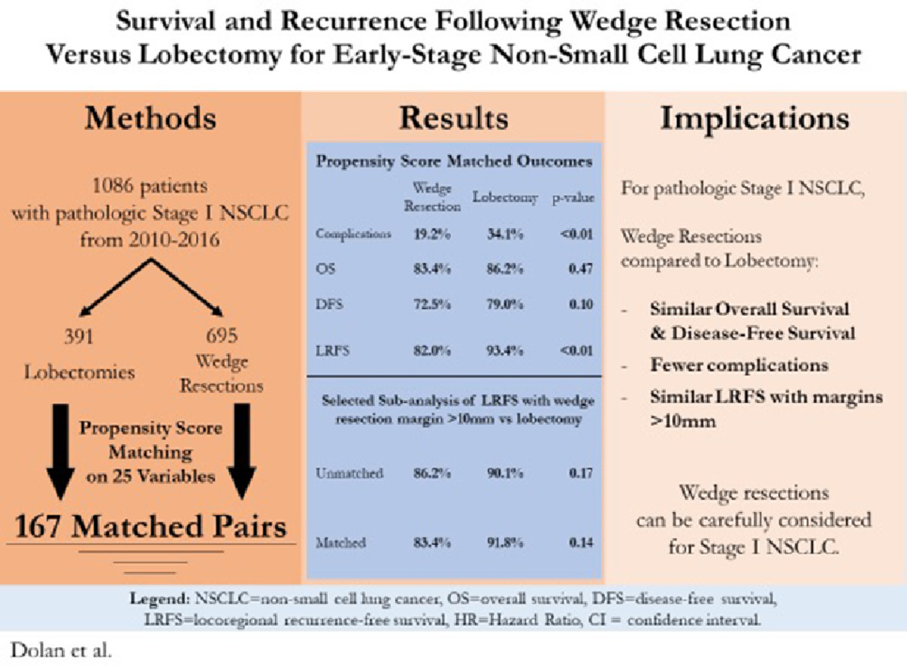

Slide 19
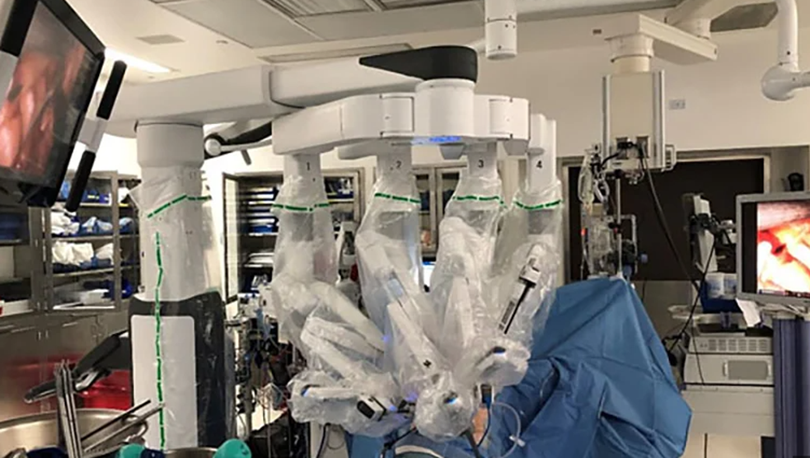
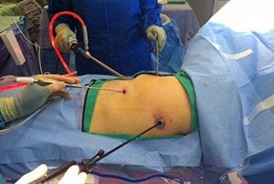
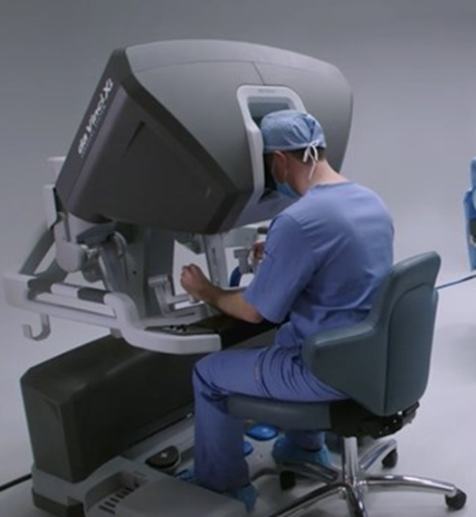

Slide 20
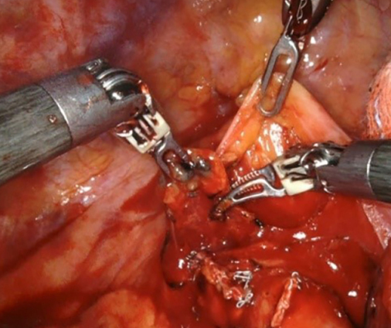

Slide 21
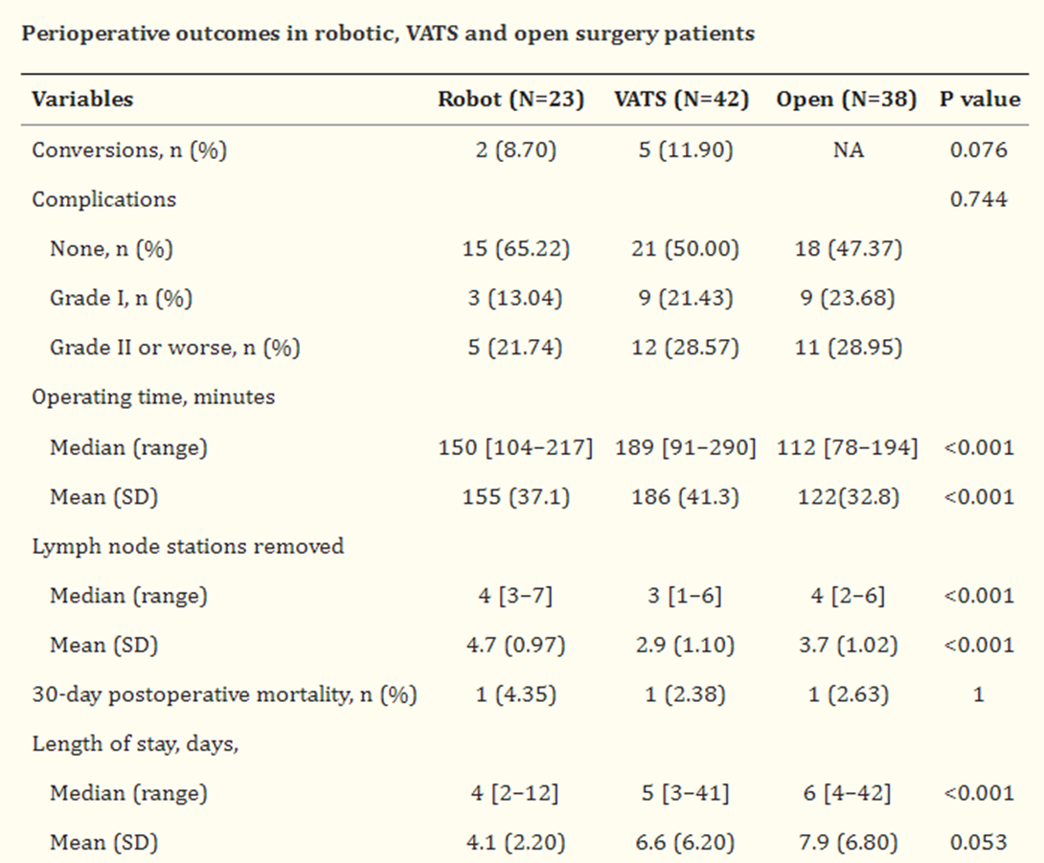
Ann Surg Oncol. 2022; 29(3): 1868–1879.
Published online 2021 Oct 6. doi: 10.1245/s10434-021-10857-7
PMCID: PMC8493945
PMID: 34613537
Comparison Between Wedge Resection and Lobectomy/Segmentectomy for Early-Stage Non-small Cell Lung Cancer: A Bayesian Meta-analysis and Systematic Review
Yucong Shi, MSc,#1 Sizhi Wu, PhD,#1,2 Shengsuo Ma, MSc,1 Yiwen Lyu, MSc,1 Huachong Xu, PhD,1 Li Deng, PhD,corresponding author1
J Thorac Dis. 2018 Feb; 10(2): 790–798

Slide 22
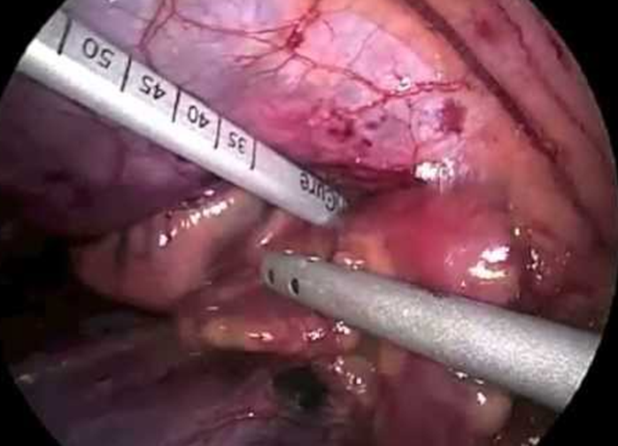
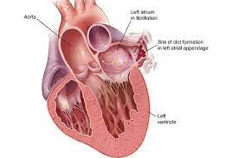
Other procedures
Left Atrial appendage ligation for prevention of stroke in patient with atrial fibrillation.
90% of atrial fibrillation embolic events originate in the left atrial appendage.
2379 participants in the occlusion group
2391 in the no-occlusion group,
followed for a mean of 3.8 years.
Stroke or systemic embolism occurred in 4.8% in the occlusion group 7.0% in the no-occlusion group
N Engl J Med 2021; 384:2081-2091

Slide 23
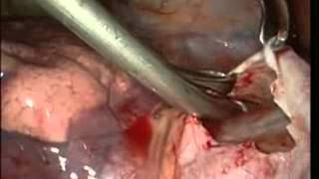
Other procedures
Pericardial window for pericardial effusions

Slide 24
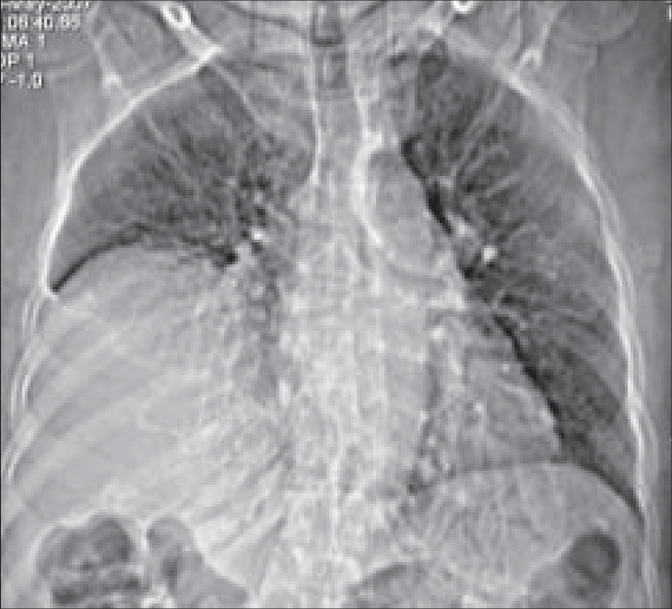
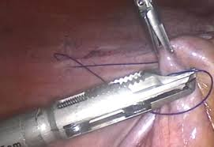
Other procedures
Diaphragmatic Plications for eventration

Slide 25
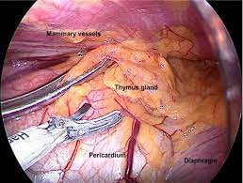
Other procedures
Thymectomy with or without thymoma
126 patients thymectomy
Lower Quantitative Myasthenia Gravis score over a 3-year period than those who received prednisone alone (6.15 vs. 8.99, P<0.001);
patients in the thymectomy group also had a lower average requirement for alternate-day prednisone (32 mg vs. 54 mg, P<0.001).
Fewer patients in the thymectomy group than in the prednisone-only group required immunosuppression with azathioprine (17% vs. 48%, P<0.001) or were hospitalized for exacerbations (9% vs. 37%, P<0.001).
thymectomy group had fewer treatment-associated symptoms related to immunosuppressive medications (P<0.001) and lower distress levels related to symptoms (P=0.003).
August 11, 2016 N Engl J Med 2016; 375:511-522

Slide 26
Thank you

